Slide 1


Fall Reflections 2021

Slide 2
COG’s Mandate
“To lead local and national communities towards sustainable organic stewardship of land, food and fibre while respecting nature, upholding social justice and protecting natural resources.”

Slide 3
About COG OSO
Local/regional chapter of national charitable organization
Volunteer-driven
Provide charitable services in the community, mostly education-based
  Some free, some cost recovery, some fundraisers
  ALL funds go to providing charitable services

Slide 4
Why Local Organic
Support for local economy and rural communities
Elimination of artificial inputs
Certainty of GMO-free food
Reduced greenhouse gas emissions
Decreased water pollution, soil degradation and erosion
Improved biodiversity and pollinator habitat
Safer working conditions for farmers and farm labourers

Slide 5
AGENDA
COG OSO in 2021
Guest Speaker – Greta Kryger of Greta’s Organic Gardens

Slide 6
Activities & Accomplishments
Now onto some of the great things we’ve done this year…

Slide 7

Fall Reflections 2020
Notes:
Fall Reflections 2020 was our very first virtual AGM. We updated members on the 2019-2020 season and had a guest speaker from Roots and Shoots, Robin Turner, speak to us about the impacts, both good and bad that COVID-19 has had on his farm and business.

Slide 8
Demonstration Garden
Jardin de démonstration
Notes:
COG-OSO maintains an organic demonstration garden at the Experimental Farm to help the public understand the principles of organic gardening. Our lead volunteers Jim and Denise Davidson manage a team of volunteers to keep the tennis court size garden in tip top shape. Unfortunately, due to regulations, volunteers were unable to get into the garden at all last year. Finally on July 4th of this year the volunteers were allowed access the gardens for the summer. Volunteers spent the summer and fall battling an infestation of weeds, most especially regular lawn and quack grass that took over the garden beds in their absence. Lead volunteer Jim Davidson is optimistic about the 2022 growing season and expects the majority of the 92 plants to bounce back.

Slide 9
Demonstration Garden
Jardin de démonstration

Slide 10
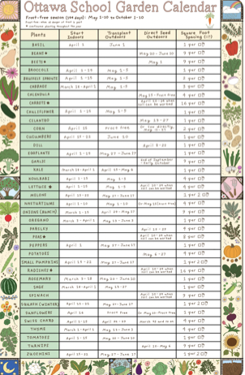
Growing Up Organic
In the 2020-2021 school year, we celebrated:
Delivering 150 workshop kits for hybrid garden workshops with a virtual facilitator. These workshops reached 36 schools and over 1,400 students from kindergarten to grade 10.
Renewing our partnership with the OCDSB for the 2021-2022 school year.
Installing 31 prebuilt garden beds at 10 partner schools
Creating an Ottawa School Garden Calendar in collaboration with Ottawa artist Robin C.
Launching the new Growing Up Organic Website -growinguporganic.org
Securing funding to begin the creation of a virtual Indigenous gardening workshop
New projects in 2021-2022:
Updating all Ontario curriculum links in our workshops
Creation of educational videos featuring local farmers
Adding Land Acknowledgements and Mindfulness exercises to all of our workshops
Notes:
Growing Up Organic
A program that connects school age children to organic food and farming by promoting school gardens in Ottawa and the region, organic food in schools and learning from farmers.
In the 2020-2021 season we celebrated:
Delivering 150 workshop kits for hybrid garden workshops with a virtual facilitator. These workshops reached 36 schools and over 1,400 students from kindergarten to grade 10.
Renewing our partnership with the OCDSB for the 2021-2022 school year.
Installing 31 prebuilt garden beds at 10 partner schools
Creating an Ottawa School Garden Calendar in collaboration with Ottawa artist Robin C.
Launching the new Growing Up Organic Website -growinguporganic.org
Securing funding to begin the creation of a virtual Indigenous gardening workshop
New projects in 2021-2022:
Updating all Ontario curriculum links in our workshops
Creation of educational videos featuring local farmers
Adding Land Acknowledgements and Mindfulness exercises to all of our workshops

Slide 11
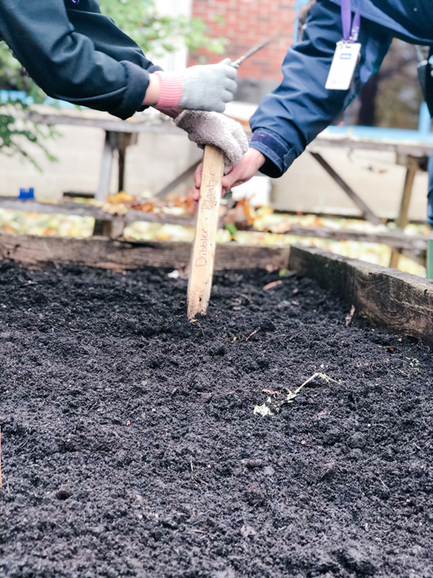
GUO – Thank You Partners & Funders
  Ottawa Carleton District School Board
  Ottawa Catholic School Board
  Conseil des écoles publiques de l'Est de l'Ontario
  Ottawa Bilingue - Association des Communautés Francophones d'Ottawa (Grant)
  City of Ottawa -Community Environmental Projects Grant Program (Grant)
  Sustain Ontario –Ontario Edible Education Network (Webinar Series)
  Rideau Rockcliffe Community Resource Centre (Virtual Gardening Workshop)
  Parkdale Food Centre -Growing Futures (Food Literacy Workshops)
  Just Food
  Ottawa School Food Network (Member)
Notes:
Growing Up Organic would like to thank all their funders and partners that help make GUO possible.

Slide 12
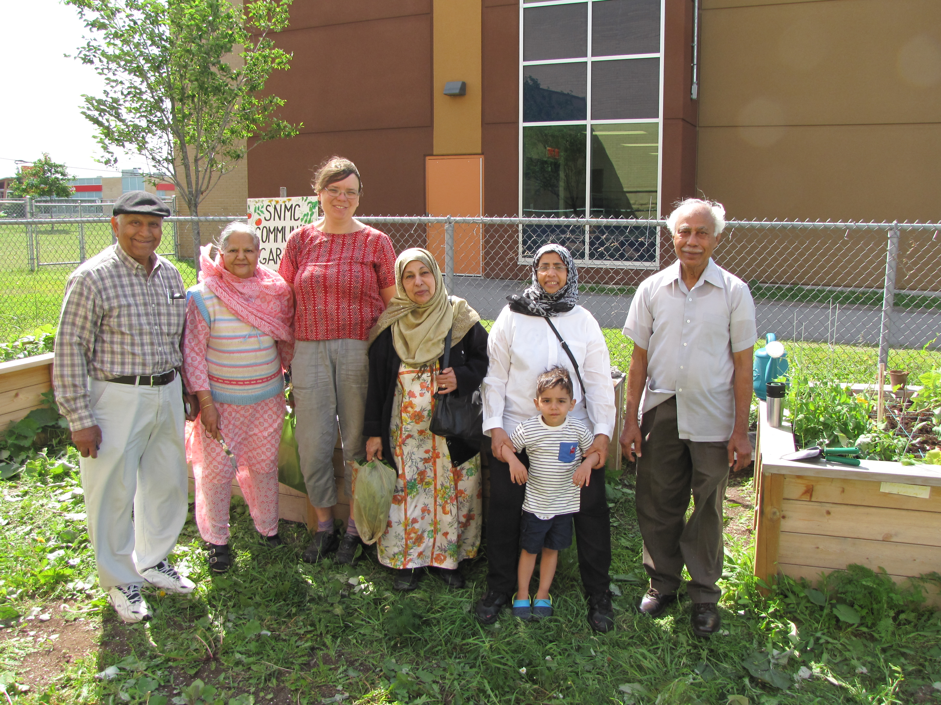
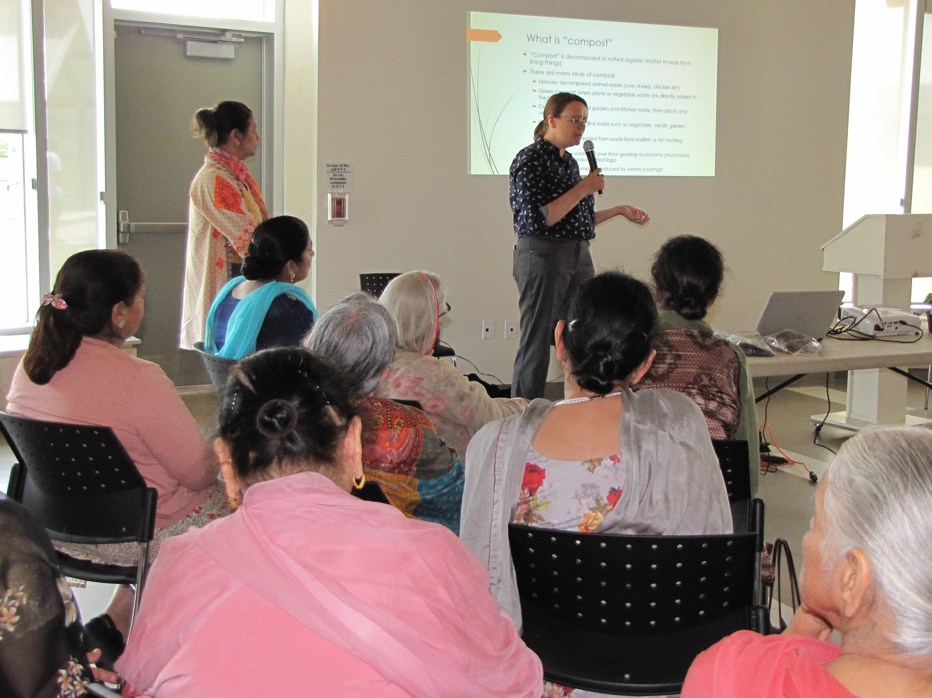
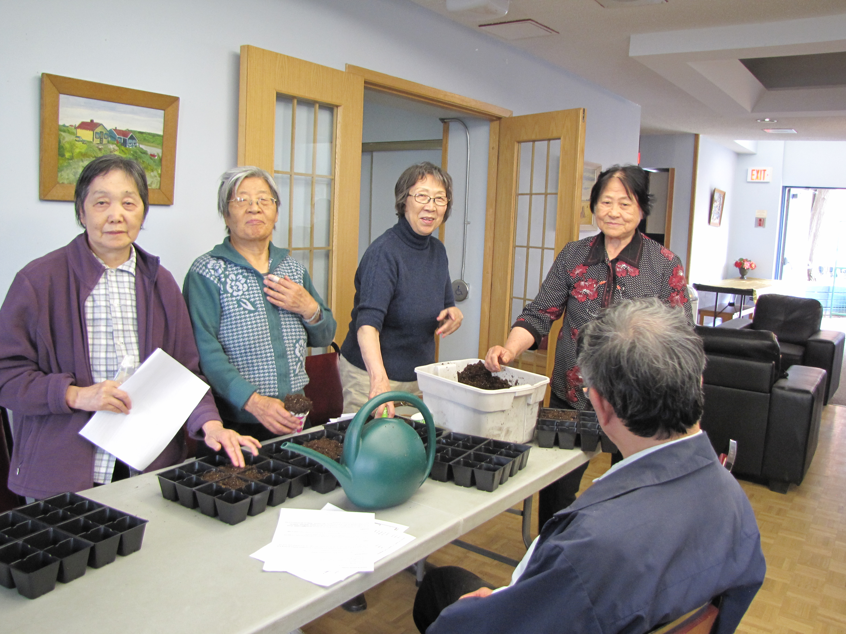
Senior Organic Gardeners- SOG
2021
Notes:
Senior Organic Gardeners has seen some amazing accomplishments during 2021 not the least of which is the Spring Symposium that drew huge compliments from participants =-all organized by SOG Manager, Chelsea Dozois! The Symposium was free for SOG participants but others were invited to participate through Event Brite which proved a meaningful and profitable fundraiser for this program clearing $860.
.
The Organic Seed Sale was hosted in one location only due to COVID restrictions, Pantry Plus in Orleans and the benefit to SOG amounted to over $900! Again amazing for the COVID environment that we all experienced!

Slide 13
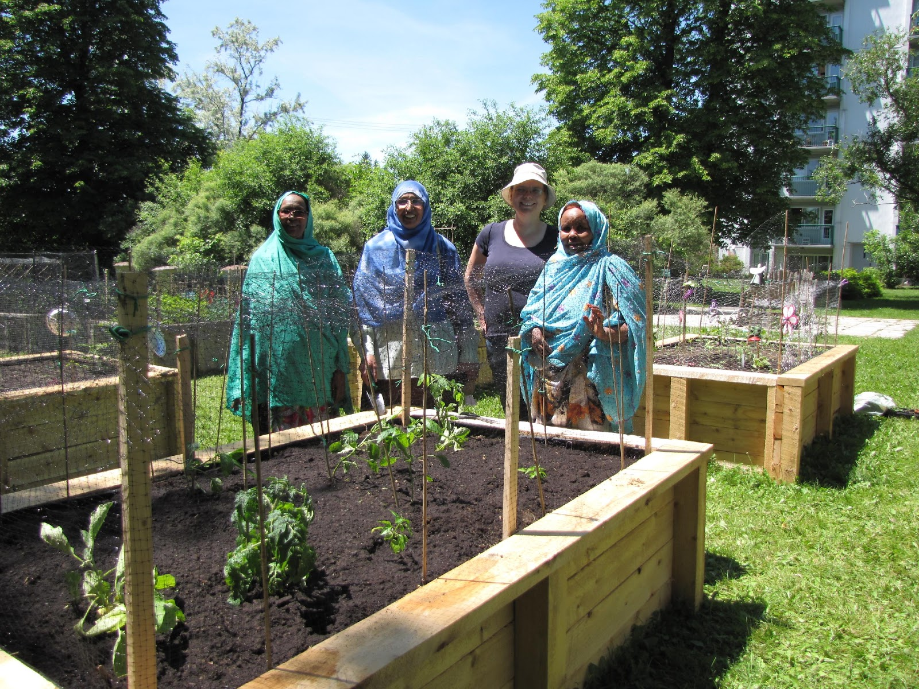
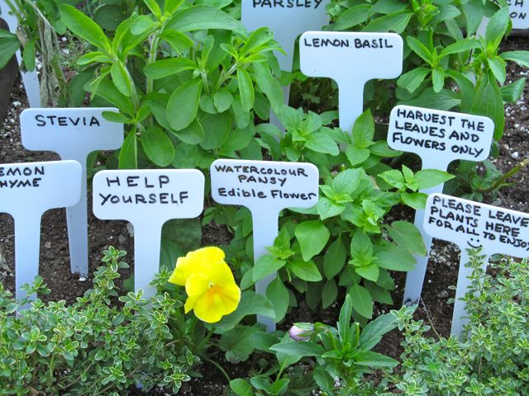
Senior Organic Gardeners - SOG
Staff
Chelsea Dozois - SOG Manager
Rob Danforth- Gardening Coaches:
Notes:
The spring summer and fall gardening program was led virtually by Rob Danforth supported by Chelsea Dozois working with seniors through community centres! The feedback from participants has been spectacular: Here is a sample “I found the sessions given by Rob very informative… He provided sound and practical advice. I appreciated his patience in ensuring that he responded to all questions being posed. I learned a lot and I am looking forward to more info sessions…”
In 2021, New Horizons for Seniors a Federal Government grant provided $25,000 which covers April 1, 2021 to the end of March 2022. This covers expenses for the SOG Winter Program coming up in November essentially Horticultural Therapy activities for senior gardeners in Ottawa and the Outaouais. This involves a gardeners’ book club, monthly surprise packages, monthly virtual get-togethers all related to gardening. In spring 2022, the second Symposium is projected and has already generated good interest.

Slide 14
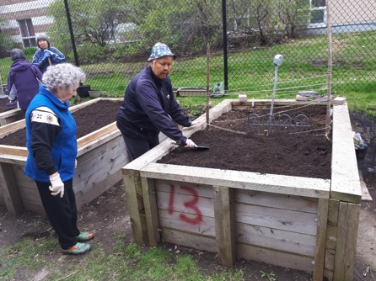
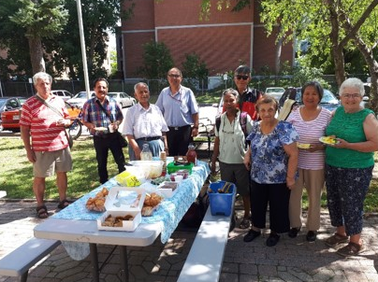
Senior Organic Gardeners- SOG
Margaret Tourond Townson
SOG Program Director (Retiring)
Betty Weil
SOG Program Director – Incoming
Siddharth S.
SOG Financial Affairs
SOG Advisory Group
Chelsea Dozois
Christine Matheson
Adele McKay
Christine O.
Hazel P.
Karen Arsenault
Honouring Mary Lou Iatail-
Former Advisory Group member passed away in 2021.
2021
Notes:
SOG is currently fundraising for the development of a SOG Guide for program leaders and Website Renewal plus funding for the seniors gardening program in 2022.
SOG has adapted to the COVID environment and is thriving under the guidance of new SOG Program Director, Betty Weil* who is replacing Margaret Townson. She will be working with SOG Manager, Chelsea Dozois and volunteer, Rob Danforth an excellent team!
SOG appreciates the support of a number of individuals, local community businesses, Just Food and other non-profits in so many ways! Thank you!

Slide 15
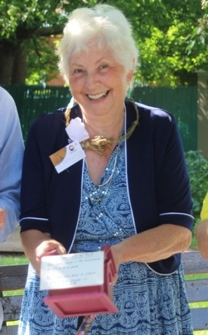
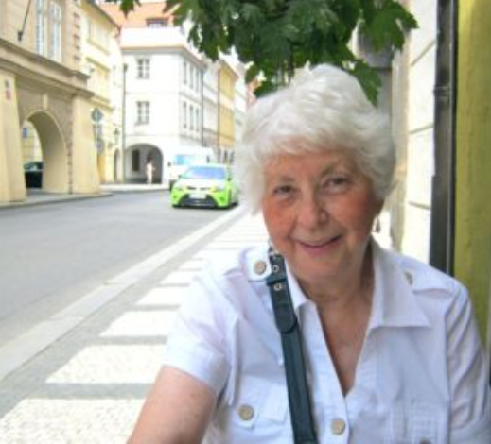
Margaret Tourond Townson
Notes:
Margaret Tourond Townson
Margaret has been part of COG OSO for over 20 years. During this time she’s held many positions on the steering committee, including chair, but most notably for today, I’d like to highlight that Margaret started the Senior Organic Gardeners program 10 years ago. During this time the program has grown significantly and seen much success. The program has touched the lives of many in the Ottawa area, but it’s Margaret’s passion and dedication to helping others that has truly inspiring.
Margaret has now stepped down from leading the program as Director. I’d just like to take a moment to recognize Margaret and her incredible work. We will be celebrating her and her success at a later date when we can all be in person.

Slide 16

Down To Earth
Notes:
DTE is a monthly e-newsletter. If you aren’t already subscribed, please join our mailing list, you can do so on our website, cog.ca/ottawa
Get updates on all kinds of events going on in our area, on COG programs and projects, and read timely articles about growing organically.
Thank you to Cynthia Nuzzi, the Down To Earth Editor and Stephanie Pelot, the layout editor for a fantastic year. Also thank you to the editorial committee and to all our content contributors, including Lloyd Strachan and representatives from SOG and GUO.

Slide 17
Volunteers
COG Demo Garden
Les B.
Denise Davidson
Jim Davidson
Helena M.
Cynthia Nuzzi
Dai S.
Steering Committee Volunteers
Barbara Koch
Cynthia Nuzzi
Caitlin Carrol
Dick Coote
Gary Weinhold
Margaret Tourond Towson
Rachel Murphy
Karen Arsenault
Betty Weil
Siddharth S.
Down To Earth
Stephanie Pilot
Cynthia Nuzzi
Jim Davidson
Rob Danforth
Lloyd Strachan
Margaret Tourond-Townson
SOG
Chelsea Dozois
Christine Matheson
Karen Arsenault
Adele McKay
Christine O.
Hazel P.
David Townson
Margaret Tourond-Townson
Betty Weil
Siddharth S.
Notes:
thank you to all our volunteers for all the hard work that you do. We wouldn’t be able to run any of this excellent programing without your help, so thank you again for choosing to spend your time with us.

Slide 18
2020/2021
Steering Committee Members
Karen Arsenault
Caitlin Carrol
Dick Coote
Jim Davison
Margaret Tourond Townson
David Townson
Gary Weinhold
Rachel Murphy
Betty Weil
*call for new members*
Notes:
I’d also like to extend a special thank you this past year’s steering committee members. Thank you for your hard work and dedication.
We’re always looking for new SC members if anyone is interested please contact me.

Slide 19
Chapter Business
Financial Report
Membership & Donations

Slide 20
Financial Summary
Current balance $38,900
Allocated to Projects:
GUO – all accounting through National
Farmer outreach $10,000
SOG $2670 plus funds at National
Discretionary funds $29,500

Slide 21
Membership and Donations
Membership in COG (with voting rights) General $60
Students $30
Certified Organic and Transitioning Farmers - FREE
Includes monthly e-newsletter (This Month in Organics) and various discounts (books, events, courses)
No charitable tax receipt for membership fee
Chosen chapter gets a portion of membership fee
Donations of $20 or more receive tax receipt
GOG National (cog.ca)
OSO Chapter (cog.ca/ottawa)

Slide 22
Get involved!
Become a member!
Join our mailing list
Come out to our events
Donate to help support COG’s programs
Volunteer with us!

Slide 23
Thank you…
COG’s key sponsors, contributors, staff, volunteers and Steering Committee members
A heartfelt thank you for coming to
Fall Reflections 2021.

Slide 24
Remembering
Mary Lou Iahtail
SOG volunteer

Slide 25
Guest Speaker
Greta Kryger

